Slide 1

All about Components

Slide 2
Objectives
Describe about Component
Class Components
Lifecycle in Class Components
Functional Components
Higher-Order Components
Component Composition

Slide 3
What is a Component?
Components are the building blocks of React applications.
A React component is a function or a JavaScript class that optionally accepts data and returns a React element that describes some piece of the user interface.
A React user interface is made up of a hierarchy of components that build up to a single component (called the root component) that is rendered in the web browser

Slide 4
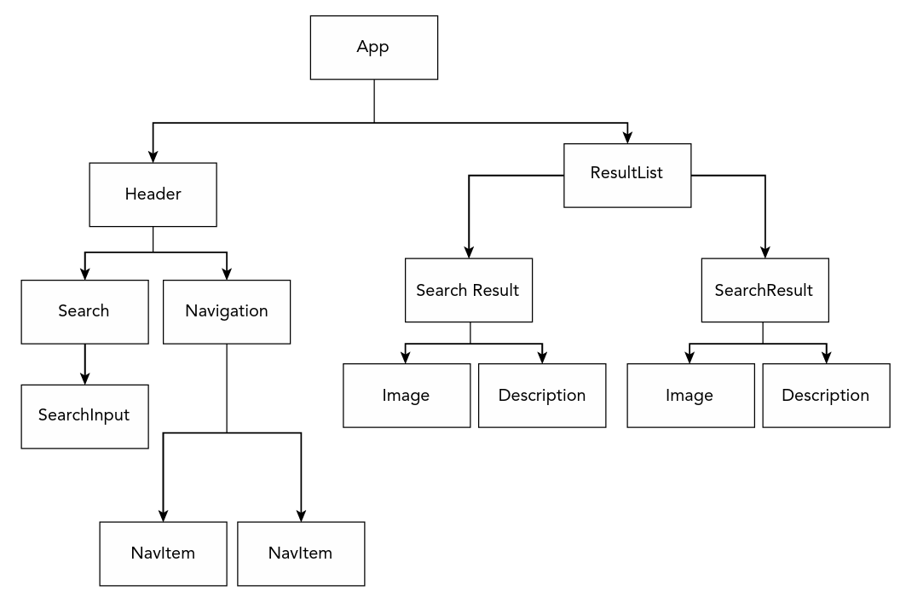
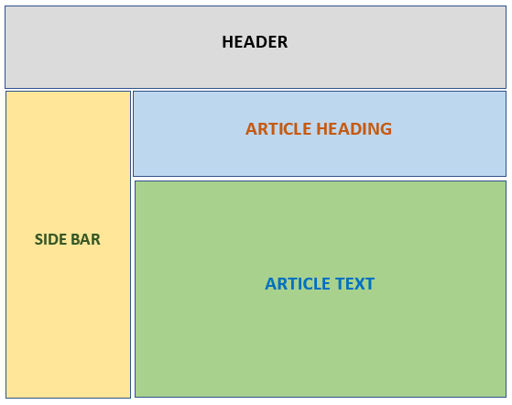
What is a Component? – cont’d

Slide 5
Importance of Components
Reusability
Encapsulation
Composition
Unidirectional Data Flow
Efficiency

Slide 6
Class Components
Class Component(Stateful Component)
Create class components, also known as stateful components, using JavaScript classes.
Manage state and lifecycle methods.
Use class components for scenarios requiring state or when specific events such as component creation or updates call for actions.
class Welcome extends React.Component {
render() {
return <h1>Hello, {this.props.name}</h1>;
}
}

Slide 7
Lifecycle in Class Components
Lifecycle methods are special methods that automatically get called as your component gets rendered and updated. They allow you to control what happens when a component mounts, updates, or unmounts.
The following are the key lifecycle methods in Class Components:
constructor(props)
componentDidMount()
componentDidUpdate(prevProps, prevState, snapshot)
componentWillUnmount()

Slide 8
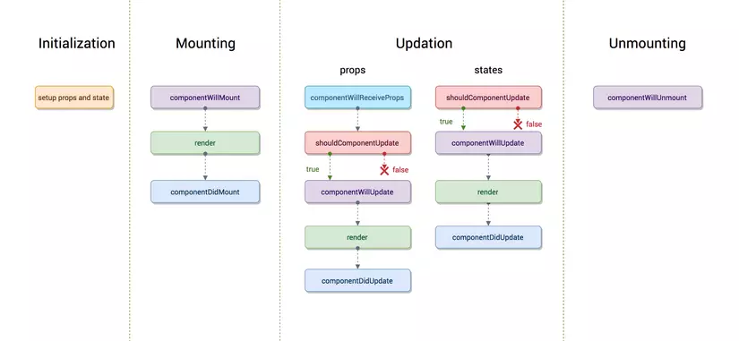

Slide 9
Mounting Lifecycle Methods
Called when an instance of a component is being created and inserted into the DOM:
constructor()
getDerivedStateFromProps()
render()
componentDidMount()
An earlier method now deprecated called componentWillMount()

Slide 10
Updating Lifecycle Methods
Called when a component is being re-rendered
Can be caused by changes to props or state
getDerivedStateFromProps()
shouldComponentUpdate()
render()
getSnapshotBeforeUpdate()
componentDidUpdate()
Two methods that are now deprecated: componentWillReceiveProps() and componentWillUpdate()

Slide 11
Unmounting Lifecycle Methods
Is called when the component is being removed from the DOM:
componentWillUnmount()
Error Handling: called when there is an error during rendering, in a lifecycle method or in the constructor of any child component
componentDidCatch()

Slide 12
class App extends Component {
constructor(props) {
super(props);
this.state = { count: 0 };
}
componentDidMount() {
console.log('Component mounted');
}
componentDidUpdate(prevState) {
if (prevState.count !== this.state.count) {
console.log('count state changed');
}
}
componentWillUnmount() {
console.log('Component will unmount');
}
incrementCount = () => {
this.setState(prevState => ({ count: prevState.count + 1 }));
}
decrementCount = () => {
this.setState(prevState => ({ count: prevState.count - 1 }));
}
render() {
return (
<div>
<p>Count: {this.state.count}</p>
<button onClick={this.incrementCount}>Increment</button>
<button onClick={this.decrementCount}>Decrement</button>
</div>
);
}
}

Slide 13
Functional Components
Hooks
It allow you to use React features such as state, lifecycle methods, and context as Class Component.
Function Component(Stateless Component)
A functional component is simply a JavaScript function with Hooks.
It returns the html code that describes the UI
function Welcome(props) {
return <h1>Hello, {props.name}</h1>;
}
doesn't need to manage state.
doesn't need lifecycle methods (although this can now be handled with the useEffect Hook).
write less code and keep things simple.

Slide 14
Effects in Function Components
The Effect Hook can be seen as a replacement for componentDidMount, componentDidUpdate, and componentWillUnmount in class components, unified into a single API.
useEffect is called after every render by default, including the initial render. It takes two arguments:
A function where you place your side effect logic.
An optional array of dependencies.
Notes:
The effect will only re-run if the values in the dependency array change between renders. If no array is provided, the effect runs after every render. If an empty array is provided, the effect only runs once after the initial render (similar to componentDidMount in class components).

Slide 15
function Counter() {
const [count, setCount] = useState(0);
useEffect(() => {
console.log('Component mounted or count state changed');
return () => {
console.log('Component unmounted or before count state changes');
}
}, [count]); // Only re-run the effect if count changes
return (
<div>
<p>You clicked {count} times</p>
<button onClick={() => setCount(count + 1)}>
Click me
</button>
</div>
);
}
export default Counter;

Slide 16
Component Conventions
User-defined component names must always start with a capital letter
These compile to React.createElement(. . .)
HeaderComponent, FooterComponent ….)
Tags starting with lowercase letters are treated as DOM tags
Built-in components

Slide 17
Higher-Order Components
A Higher-Order Component (HOC) allow reuse component logic, which can help keep your components small and focused.
They can be used to modify props, change rendering, abstract state, and wrap components for context or theme.

Slide 18
Higher-Order Components – cont’d
// Higher Order Component
function withExtraProp(WrappedComponent) {
return function EnhancedComponent(props) {
return <WrappedComponent {...props} extraProp="I am an extra prop!" />;
}
}
// Regular Component
function MyComponent(props) {
return <div>{props.extraProp}</div>;
}
// Enhanced Component with HOC
const EnhancedComponent = withExtraProp(MyComponent);
// Usage
<EnhancedComponent /> // Will render: <div>I am an extra prop!</div>

Slide 19
Component Composition
It is a natural pattern of assembling complex UIs by piecing together components like Lego blocks.
It involves building small and reusable components and combining them to create more complex user interfaces.
Benefits of Component Composition: Reusability, Separation of Concerns, Testability.

Slide 20
Component Composition – cont’d
function App() {
return (
<div>
<Header />
<MainContent />
<Footer />
</div>
);
}
function Header() {
return <h1>Welcome to FPT of Website!</h1>;
}
function MainContent() {
return (
<div>
<Article />
<Article />
</div>
);
}
function Article() {
return <p>This is an article.</p>
}
function Footer() {
return <h3>Thanks for visiting!</h3>;
}

Slide 21
Exercise 9: React Component 1

Slide 22
Summary
Concepts were introduced:
Describe about Component
Class Components
Lifecycle in Class Components
Functional Components
Higher-Order Components
Component Composition

